Slide 1

State of New Hampshire
Department of Health and Human Services
Division of Program Quality and Integrity
Presented to House Finance Division III
February 18, 2021
Meredith Telus

Slide 2
Agenda
Overview of Division
Key Functions
Key Partners
Accomplishments
Key Challenges
Financial Summary
Summary of Department Audits

Slide 3
Overview - DPQI
The Division was created in 2019 to be generally responsible for outcomes, performance measures, and accountability; strategic and operational planning; data reporting and analysis; business process analysis; project management and implementation; internal audit; and enterprise risk management.
The Division includes:
The Bureau of Program Quality; and
  formerly known as the Bureau of Quality Assurance and Improvement
The Bureau of Program Integrity.
  formerly known as the Bureau of Improvement and Integrity

Slide 4
DIVISION OF PROGRAM QUALITY AND INTEGRITY
Department Unique Identifier: 095
Meredith Telus, Director
  603-271-9622
  Meredith.telus@dhhs.nh.us
Tashia Blanchard, Bureau Administrator, Program Integrity
  603-271-8763
  Tashia.Blanchard@dhhs.nh.us
Susan Drown, Bureau Administrator, Program Quality
  603-271-9204
  Susan.Drown@dhhs.nh.us

Slide 5
DIVISION OF PROGRAM QUALITY AND INTEGRITY (DPQI)
Mission
The Division of Program Quality and Integrity supports the mission of the Department of Health and Human Services by providing data-informed program development, quality, and performance improvement and ensuring accountability in operations and financial integrity.

Slide 6
Overview – Bureau of Program Integrity
The Bureau of Program Integrity (BPI) provides a comprehensive, integrated approach to service excellence by preventing errors and fraud in NH DHHS programs and by maximizing revenue sources. BPI ensures fraud, waste, and abuse is monitored and controlled. All BPI functions are directed toward strengthening quality, accountability, and public confidence in the delivery of health and human services.
The Bureau includes:
Special Investigations Unit;
Medicaid Program Integrity Unit;
Medicaid Third Party Liability Unit;
Quality Assurance Unit;
Financial Compliance Unit; and
Internal Audit.

Slide 7
BPI – Fraud, Waste, and Abuse (serving Medicaid)
Key Activities and Services
Medicaid Program Integrity Unit
Medicaid Program Integrity Unit investigates Medicaid provider fraud, waste, and abuse and ensures compliance with Medicaid regulations and rules. PIU also oversees provider enrollment to ensure providers are properly screened and have the proper credentials.
Third Party Liability Unit
Third Party Liability Unit ensures Medicaid is the payer of last resort and avoid unnecessary costs. TPL verified 9,374 Medicaid member with private insurance in SFY 2021.

Slide 8
BPI – Audit Units (Medicaid and FNS)
Key Activities and Services
Quality Assurance
The Quality Assurance Unit monitors the accuracy of Food Stamps per Food and Nutrition Services (FNS) requirements, and Medicaid eligibility determinations in a manner specifically prescribed by federal regulations. Supports Bureau of Family Assistance by working to correct errors and ensure proper benefits. (Over 1,000 audits per year).
Special Investigation Unit
Special Investigation Unit investigates and prosecutes client fraud (Medicaid, TANF, or Food Stamp benefits). SIU processed more then 1325 investigations and claim reviews for SFY 2020.

Slide 9
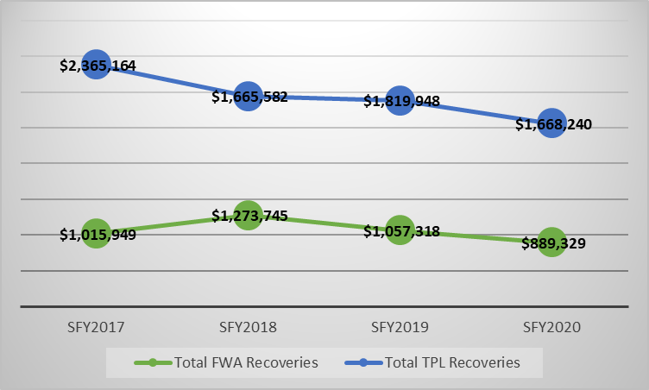
BPI Recovery of Overpayments
FWA Recoveries includes beneficiary and provider over payment recoveries.
TPL Recoveries includes funds recovered for subrogation cases and recoveries from other insurances.
FWA recovery reduction is due to the reduction in case closures noted on the previous slide.
TPL recovery reduction is due to the move to Managed Care (MCO). Claims and TPL recoveries are processed by the MCOs.

Slide 10
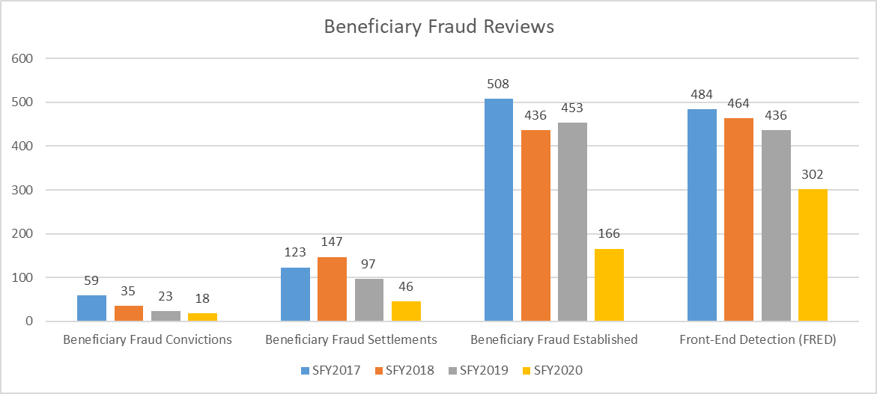
BPI Beneficiary Case Reviews
Case closures have reduced due to staff turn over, vacancies, and changes in process which have resulted in reduced settlements.

Slide 11
BPI – Audit Units (Department-wide)
Key Activities and Services
Financial Compliance Unit
Supports and assists program areas with contract compliance and sub-recipient monitoring by performing financial reviews of contractors; performs financial reviews of Nursing Facilities; coordinates and assists with Department response to federal audits.
Internal Audit
The Internal Audit function is responsible for identifying and auditing areas of risk within the Department and reporting recommendations for improved internal controls to Department management; coordination of LBA audits and LBA audit follow-up.

Slide 12
BPI Key Accomplishments
BPI established several data interfaces and Medicaid data updates to reduce overpayments and ensure accurate claims processing, including: Department of Corrections, Vital Records, and Department of Defense.
BPI implemented Managed Care Organization (MCO) monitoring of Third Party Liability functions performed by the MCO to ensure proper processing of claims when there is a third party liable.
BPI partnered with the DHHS Grants Administrator and Contracts Unit to establish a sub-recipient monitoring program based on risk. Working with program and finance, BPI supports financial risk assessments and appropriate monitoring of the Department’s sub-recipients of federal funds.
BPI has worked closely with the AG’s Medicaid Fraud Control Unit (MFCU) and County Attorney’s Offices to prosecute fraudulent activity, resulting in conviction of a Home Health provider who was fraudulently billing Medicaid and a criminal conviction of a beneficiary (ordered to repay DHHS over $108,000).

Slide 13
BPI Key Challenges
Data access. We need information be successful in our investigation work. Access to data from different agencies, cities, and federal databases is necessary to prevent fraud.
Technology. Software and contracts for the technology necessary to enhance fraud detection and deterrence in NH.
Recruitment. Imperative to find highly-skilled staff and managers. BPI has a 25% staff vacancy rate.

Slide 14
Bureau of Improvement & Integrity Staffing
Governor Recommended Positions SFY22 | % | 9510 – Bureau of Improvement and Integrity
64 | 100% | 7935 – Office of Improvement & Integrity

Slide 15
Budget Chart comparison - BII

Slide 16
Bureau of Improvement & Integrity
 | Accounting Unit Title | Division | Bureau | Budget Book Page # | Budget Briefing Book Page #
9510-7935 | Office of Improvement and Integrity | OCOM | BII | 1168 | 237

Slide 17
Overview – Bureau of Program Quality (BPQ)
The Bureau of Program Quality (BPQ) provides formal ongoing assistance with quality oversight, improvement, program evaluation, and quantitative reporting to Department programs and the public through its expert reviewers, quality improvement specialists, evaluators, and analysts. Data are synthesized and disseminated to leadership, policy makers and stakeholders in an effort to ensure each have an optimal understanding about the quality and effectiveness of services administered by the Department. $6,508,040 $7,107,978
The Bureau includes:
Data Analytics and Reporting;
Medicaid Quality Program;
Substance Misuse Planning and Evaluation; and
Health Services Assessment.

Slide 18
Data Analytics and Reporting-1
Key Activities and Services
Department-wide & Public
Ongoing and ad hoc analysis of the intersections between Medicaid, behavioral health, public health data and other data
Information resource for stakeholders, policy makers and the public on statistics and data sources related to Departmental functions
Medicaid Analytics
Provide analysis and insight of enrollment, utilization and cost data to support Medicaid program policy development and financial management
Analysis to support health care delivery system improvement
Analysis and performance reporting for development and monitoring of Medicaid waivers, managed care directed payments and quality incentive programs

Slide 19
Data Analytics and Reporting-2
Key Activities and Services
Medicaid Quality Monitoring
Management of the Medicaid Quality Information System (medicaidquality.nh.gov)
Processing and reporting on 7,000 data points a quarter across 200+ quality measures
Lead Medicaid Federal quality reporting
Behavioral Health Analytics
Reporting and analytics/dashboarding to support Behavioral Health program development, monitoring and quality improvement
Monitoring & analysis of key metrics for State’s Mental Health Settlement Agreement
Provide fresh insights into behavioral health systems through data science & cross-data system analysis
Data Systems Oversight
Management & quality improvement of Medicaid claims/encounters, Comprehensive Healthcare Information System (commercial insurance and Medicare), Phoenix (community mental health), WITS (drug and alcohol) data systems

Slide 20
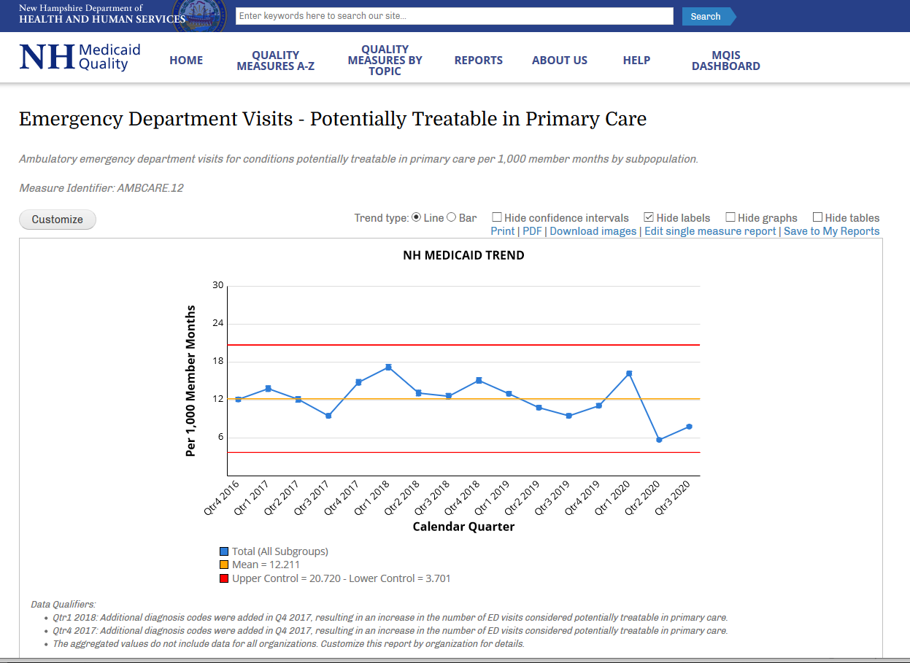
BPQ – Medicaid Quality Information System (medicaidquality.nh.gov)

Slide 21
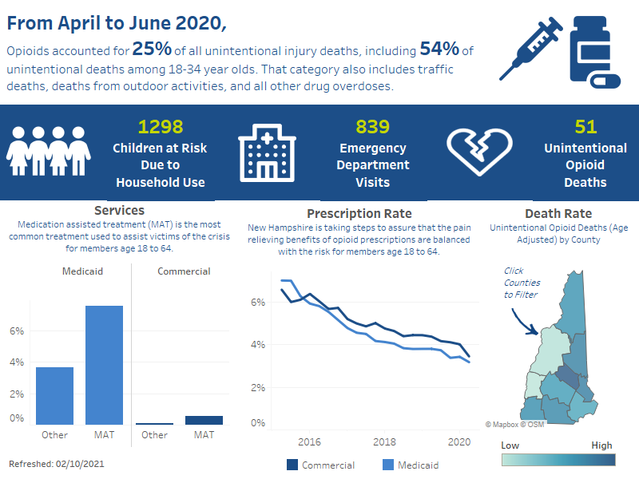
Development of EBI Opioid Crisis Dashboard
DRAFT
DRAFT

Slide 22
BPQ Medicaid Quality Program
Key Activities and Services
Department-Wide & Public
Medicaid Member MCO quality consumer guide for selecting a health plan.
Monthly MCO summary reports designed and distributed to DMS, DCYF, DPHS, BDAS, BMHS, DLTSS.
Support DHHS programs in designing key performance indicators, and quality management systems.
Division of Medicaid Services
Develop and implement the NH Medicaid Quality Strategy to assure that Medicaid members have access to quality care from Managed Care Organizations (MCO).
Develop and implement structured evaluation, quality planning and reporting for Medicaid 1115 Waivers, 1915(b) Waivers and Directed Payments.

Slide 23
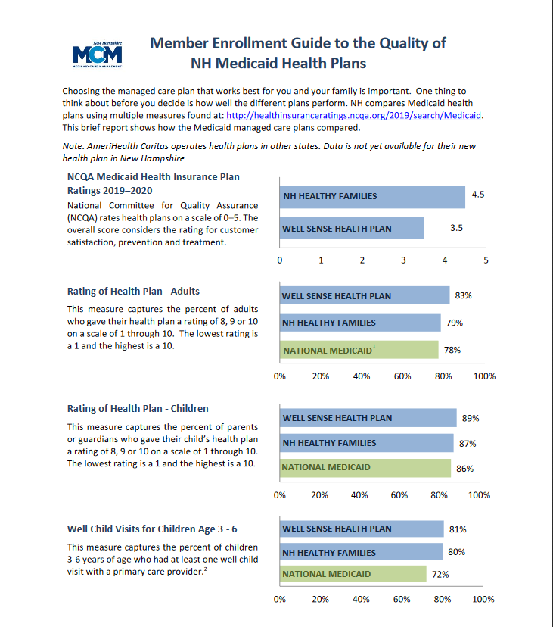
BPQ – Medicaid Quality Consumer Guide of Health Plans https://medicaidquality.nh.gov/member-enrollment-guide-quality-nh-medicaid-plans

Slide 24
BPQ Substance Misuse Planning & Evaluation
Key Activities and Services
Cross-Departmental and State Partners
Identifying the prevalence and consequence of substance misuse on individuals, families, communities, institutions, and the state as a whole in collaboration with DHHS program areas and multi-state agencies
Department-wide
Support and guide DHHS leadership and program areas on the utilization of data to better understand the impact of substance misuse on the various populations served by the Department
Develop strategies and programming to better address substance misuse in an integrated manner and identify methodologies for reporting quality, performance and outcomes
DBH, Bureau of Drug & Alcohol Services
Provides matrixed leadership in identifying key metrics, evaluation methodologies and reporting framework for a broad range of substance misuse programming

Slide 25
BPQ Health Services Assessment
Key Activities and Services
Department-wide
Sentinel Event reporting oversight, including data analytics, coordination of cross-system reviews, identifying system issues and opportunities for operational improvements
Development of quality review processes and procedures to assist the Department with provider/service reviews and reliable qualitative and quantitative data collection
Bureau of Elderly and Adult Services
Home and community-based care program reviews of 8 Case Management Agencies conducted per compliance with the Federal 1915(c) HCBS Waiver, Quality Improvement Strategy
BMHS
Implementation of Quality Service Reviews, data analysis, and quarterly quality improvement monitoring of the 10 community mental health centers
Re-designation and quality site reviews of the 6 psychiatric inpatient facilities that provide involuntary mental health treatment

Slide 26
BPQ Key Accomplishments
Subject matter direction on development of standardized substance misuse related metrics and data integration across DHHS programs and Medicaid for monitoring and reporting quality, performance, and outcomes.
Development of a dynamic and robust qualitative review process that over the past three years and counting, has shown a 9% improvement in the statewide Quality Service Review Scores, indicating improved services and outcomes for individuals served by community mental health centers.
Development and operationalization of Managed Care Organization programs to incentivize quality improvement. Programs include: Quality Withhold and Incentive Program, NH Directed MCO Alternative Payment Models, and Performance Based Member Auto Assignment Program.

Slide 27
BPQ – Key Challenges
Lack IT infrastructure to support comprehensive agency/provider service reviews with qualitative and quantitative data collection and analysis, to ensure meaningful reports and program oversight.
Highly skilled DHHS workforce needed for continued development of quality management, data analysis and reporting.
Increased Federal and State expectations on Quality without additional resources.

Slide 28
Bureau of Quality Assurance & Improvements Staffing
Governor Recommended Positions SFY22 | % | 9550 – Bureau of Quality Assurance & Improvements
28 | 100% | 6637 – QAI Operations

Slide 29
Budget Chart comparison - QAI

Slide 30
Bureau of Quality Assurance & Improvement
 | Accounting Unit Title | Division | Bureau | Budget Book Page # | Budget Briefing Book Page #
9550-6637 | Quality Assurance & Improvement Operations | OCOM | QAI | 1182 | 252

Slide 31
5% Incremental / decremented Outcome
Data systems enhancements to ensure cost containment and quality review
Quality and Performance Measures (Medicaid and Beyond)
Enhanced Contract Management
In-house Strategic Planning Expertise
Fewer reviews, increased risk of undetected fraud, increased repeat audit findings, increase risk of poor Medicaid cost-containment
Quality standards will necessarily decrease – fewer samples/lower distribution selected for review

Slide 32
Department Audits
Centers for Medicaid Services – Program Integrity (1x/3 years)
One-Off
LBA
Bureau of Developmental Services, Unspent Appropriations (2016)
Recurring
Payment Error Rate Measurement (PERM) (1x/3 years)
Single Audit (LBA, KPMG)
CAFR Audit (LBA, KPMG)
HRSA – Maternal & Child Health Care
HUD – Continuum of Care Program
OIG – SUD program (in progress)
Title IV E Eligibility for Foster Care
Internal Control Review of Medicaid Eligibility (2016)
Therapeutic Cannabis Program ID Card Timeliness (2019)
New Hampshire Hospital (2020, Financial Audit)
Sununu Youth Services Center (2021, In progress)
OIG – Criminal Background check requirements for child care

Slide 33
Department Audits – Findings and Status
One-Off
HUD Audit Finding: Subrecipients may not operate their program in compliance with regulatory requirements because the State has not completed and distributed program policies.
LBA
New Hampshire Hospital Audit Finding: The Hospital does not have a formal risk assessment process in place for its financial accounting and reporting functions including an information technology security assessment.
Recurring
Single Audit Finding: Noncompliance with the maintenance of effort requirements included in the PHEP and HPP program notice of award. Questioned Costs: $544,000 including match amounts.
Current Status: Worked with program area, DAS, and CDC partners and reduced overpayment amount to $51,000.
Current Status: The Hospital is reviewing mechanisms for an appropriate risk assessment process and will update on Transparent NH.
BHS ensure subrecipient agencies had the policy manual describing the disability determination process on pages 7-11 and page 32.

Slide 34
Data Security Audits
2018
CMS MARS-E
2019
2020
CMS MARS-E New Audit
Single Audit
Numerous Findings:
The State does not have an Information Security Insider Threat Program
IRS Federal Tax Information (FTI)
100+ Findings
FBI Criminal Justice Information (CJI)
Numerous Findings
One of the Findings: The Department does not have a Data Classification Policy
Most findings are the result of the Department not having an FTI system for the Bureau of Family Assistance
100’s of Findings:
One of the Findings: Access Databases cannot be used to store CJI.
Access to the Social Security Administration (SSA) federal information cannot be provided – access to the data for this audit was not permitted by SSA. Requires memo from CMS to SSA.
Numerous Findings
One of the Findings:
Social Security Administration (SSA) Representative Payee
CMS MARS-E
Single Audit - Medicaid
Continuation of findings remediation and mitigation
FBI Criminal Justice Information (CJI)
Credit card devices were not correctly protected to prevent tampering
Payment Card Industry
Continuation of findings remediation and mitigation
Numerous Findings
One of the Findings: The Department does not have a SOC 2 Report policy and process
Audit on-going

