Slide 1
NH House Div III
Hon. Robert E Clegg and Carolyn Virtue
March 10, 2021

Slide 2
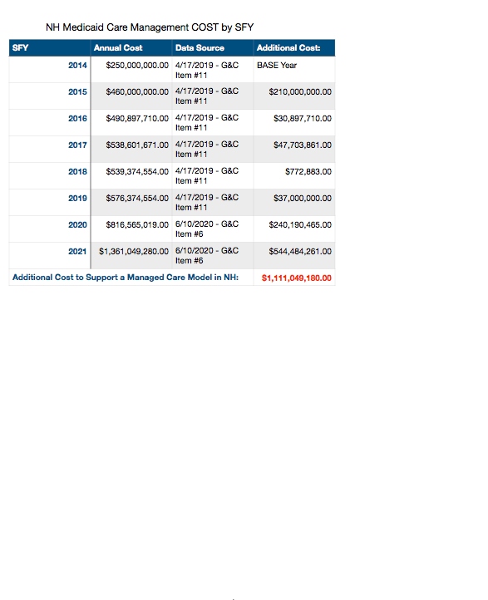
Medicaid Care Management
Currently, managed care interventions are provided to only 3% of the enrolled recipients.
The department implemented Medicaid Care Management through a contract which explained the contract “includes anticipated savings in the Medicaid Program of thirty million dollars following the implementation of a Managed Care Program.”
No savings realized to date.

Slide 3
Case Management
Case Management is a medical service deﬁned by CMS through federal regulation, which is delivered to a recipient. Case Management consists of services which help recipients gain access to needed medical, social, educational, and other services. Case Management can be “targeted” specifically to defined groups of enrollees such as waiver populations or defined groups of individuals such as elderly and adult disabled. Case management must be provided by individuals who are free from a conflict of interest, such as a fiduciary responsibility to an employer. Case management services include assessment of an eligible recipient; development of a specific care plan; referral to services; and monitoring and follow-up activities. Case Management may NOT be provided by an insurance company.
Care Management is NOT Case Management. When Care Management is provided by an insurer, such as an MCO, it is considered to be an administrative or financial function of the insurance company by CMS and federal regulations. Care management is not a recognized medical service delivered to a recipient. Although the function may be performed by medical personnel, these individuals are not employed to deliver a medical service to a consumer and they are not required to be free from conﬂict of interest. The primary goal of care management is to authorize and manage consumption of services to beneﬁt the bottom line line of an insurer, which may or may not result in a positive outcome for the recipient.
NH has a rate disparity issue with its Case Management rates, which is prohibited. It has been stated the budget before you is intended to fix this issue. Please consider putting a note in the budget which specifies the rate.

Slide 4
Three DHHS Contracts
No Deliverables Yet
University Of Maine, Muskie School of Public Service
March 2, 2012 - New Hampshire was the first State in the country to receive new Medicaid grant dollars under the Balancing Incentive Program (BIP) and was awarded $26.5 million over three years— provided by the Affordable Care Act to keep people out of institutions and living productive lives in their communities. A portion of these funds were used to contract with the University of Maine, Muskie School of Public Service and in November 26, 2013 work began on developing a “Conflict Free Case Management” model for NH. The resulting report was not released by NH DHHS because they did not like the reports solutions. Three of NH’s 1915 (c) waivers were subsequently put, by CMS, under a Corrective Action Plan for failing to mitigate the conflict of interest violations for the case management provided.
Navigant (Guidehouse)
The Navigant (Guidehouse) contract was first approved by G&C on May 17, 2017, as item 12 B and subsequently amended by G&C on 4/3/2019, as Item 14. The report has yet to be released by DHHS. The contract amount was $754,300. The contractor met with over 100 Stakeholders to solicit input to develop a plan for the CFI Waiver. The report was due by the contract end date, June 30, 2020. On August 3, 2020 in regard to questions about the report, department staff reported “"“We are validating the stakeholder input through our data driven work” . Once again, the resulting report was not released by NH DHHS because they did not like the reports solutions.
Alvarez & Marsal
The sole sourced Alvarez & Marsal went through G&C on September 23, 2020 as Information Item #B. The contract amount is $1,580,000 all federal cares act funds. The contract purpose is stated as The contract purpose is stated as “The purpose of this agreement is for the Contractor to conduct a strategic assessment of the Department's operations to quantify the financial impact the COVID-19 pandemic has had on the Department's expenditures and revenues and general operations. The Contractor will identify programmatic quality improvements to increase the efficiency of Department operations, produce cost savings, and Improve the delivery of services during and after the COVID-iO pandemic.The contract specified reliance on “Department Leadership” to develop a plan to identify and discuss “strategic priorities, legislative and funding challenges presented by the COVID-19 pandemic, and long-term goals, with Department leadership.” without any stakeholder input. If stakeholder inout had been solicited, this would be yet one more report they did not like the solutions of.

Slide 5
MMIS
Medicaid Management Information Systems
Is DHHS Prepared to manage a change of this magnitude today?
The new MMIS system contract was originally let in December 2005 to Affiliated Computer Services (which was acquired by Xerox in 2010). The total contract cost of the initial contract, was for $60 million: “$26 million for the design phase, and $34 million for the full five-year operational phase.” The design phase was supposed to be complete by the end of 2007, and operations were scheduled to begin on 1 January 2008. By June of 2014, shortly after the new system went live the cost had skyrocketed to over $117 Million dollars.
The Union Leader reports that the MMIS design “has been modified at least five times, with the Executive Council repeatedly voting to extend the contract after Xerox missed eight deadlines over the six-year period.” According to the paper, the reason for the design changes and delays were caused by both state and federal additional system requirements, as well as contractor implementation problems.
New Hampshire continued to paying EDS (now owned by HP), the legacy vendor and losing bidder to keep the existing system operational for nine years at a cost of over $8 million per year. We paid almost as much to maintain the legacy system as we did for the new system simultaneously.
The new system was authorized because DHHS claimed an immediate need for a new system for many reasons.

Slide 6
NH State Plan Amendments (SPA) for Case Management
NH has several SPA for case management which have been approved by CMS. The department is not in compliance with the SPA it has filed for the waivers which are under Corrective Action.
Not complying with State Plan Amendments puts NH at financial risk of recoupment.

Slide 7
Money Follows The Person
Nursing Home Transition Grant
NH started off with a robust program contracted to the New Hampshire Health Care Association and the New Hampshire Independent Case Management Association which was very successful by any measure. NH DHHS made the decision to bring the program back into the department and the program floundered.
NH missed the September of 2020 opportunity when the Centers for Medicare & Medicaid Services (CMS) offered 33 states up to $165 million in supplemental funding to states currently operating Money Follows the Person (MFP) demonstration programs.
There will be 2021 Awards as well.

Slide 8
NH LTSS
For over 20 years NH has had a stated goal to re-balance it’s Long Term Services and Supports (LTSS) for our elderly and adult populations and move from a heavily institutional based model to a less costly model with more community based care options. NH DHHS has expended millions of federal dollars (SIM, BIP, MFP, etc) to accomplish this stated goal. There is no measure by which you could established this goal has been achieved.
Look at the demographic data for the COVID-19 deaths. Over 70% of the deaths were residents of NH Nursing homes. If we have learned nothing else from the experience of the pandemic, it has brought to light our failures in LTSS and its time we acknowledge them.
Once again for the next biennium the institutional arm of the system will be funded at far greater than the community alternative. If the immediate needs of the community based care systems are not addressed, we will lose the option of community based care.
NH has State Plan Amendments (SPA) for the 1915 (c) waiver case management which have been approved by CMS. The department is not in compliance with the SPA for the waivers which are under Corrective Action.

Slide 9
Duplication of Effort
Example 2021 HB 2 - 38 and Managed Care Contract Deliverable
38 Appropriation; Department of Health and Human Services; Expanded and Continued Admission, Discharge and Transfer Event Notifications. There is hereby appropriated to the department of health and human services the sum of $200,000 for the biennium ending June 30, 2023 to support expanded and continued admission, discharge and transfer event notifications capabilities that accelerate notifications of a patient’s admission, discharge, and/or transfer to other health providers involved in a patient’s care. The governor is authorized to draw a warrant for said sum out of any money in the treasury not otherwise appropriated.
2.1.122.1 "Transitional Care Management" means the responsibility of the MCO to manage transitions of care for all Members moving from one clinical setting to another to prevent unplanned or unnecessary readmissions, ED visits, or adverse health outcomes.2:1.122.2 The MOO shall maintain and operate a formalized hospital and/or institutional discharge planning program that includes effective post-discharge Transitional Care Management, including appropriate discharge planning for short-term and long-term hospital and institutional stays. [42 CFR 438.208(b)(2)(i)] 2.1:123 Transitional Health Care 2.1.123.1 "Transitional Health Care" means care that is available from a primary or specialty Provider for clinical assessment and care planning within two(2) business days of discharge from inpatient or institutional care for physical or mental health disorders or discharge from a Substance Use Disorder treatment program.

Slide 10
Real People
DHHS has lost sight of its mission and what it means to address the needs of real people, with real issues and to give them the tools they need to continue to live in the real world. Institutionalization serves neither the state nor the people we call of fellow citizens. We spend millions of dollars looking for solutions that are not accepted when offered. It’s time we hit the pause button and implement the solutions we have paid for and stop spending money because we don’t the solutions offered and dedicate those funds to the medicaid recipients. Last session, you increased the DHHS budget by 24%, the results so far have not resulted in improvement. It is my personal belief we should hold on any new spending ideas until we see the results of the 24% increase of last sessions ideas. No corporation would continue to spend money without causative results.

